Slide 1

SPEECH EMOTION RECOGNITION
Presented by Dheepan G

Slide 2

Developing a Comprehensive Speech Emotion Recognition ui to predict emotions
INTRODUCTION
Speech Emotion Recognition speaks about the prediction of the emotion of the speaker .
This presentation outlines a comprehensive approach to developing a speech analysis tool that captures or loads audio and perform some analysis on it using machine learning algorithms and predict the emotion

Slide 3





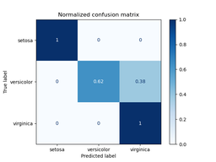


Train the models
Intergration and Development
Load
Audio files
Noise reduction
Feature Extraction
Separate dataset
Classify the emotions
Confusion matrix generation
Train the models
Predict the emotions

Slide 4
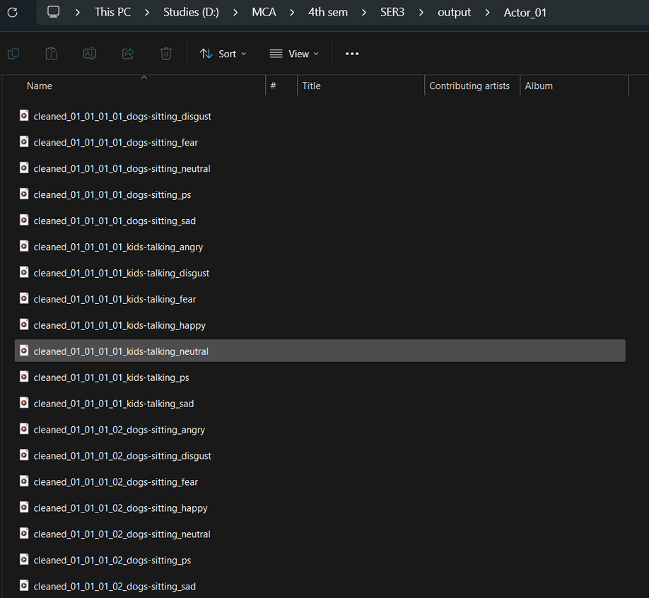
Noise Reduction
butter_lowpass_filter
Creates Butterworth low-pass filter coefficients based on the cutoff frequency and the sampling rate.
apply_lowpass_filter
Applies the Butterworth low-pass filter to the audio data, reducing high-frequency noise.

Slide 5
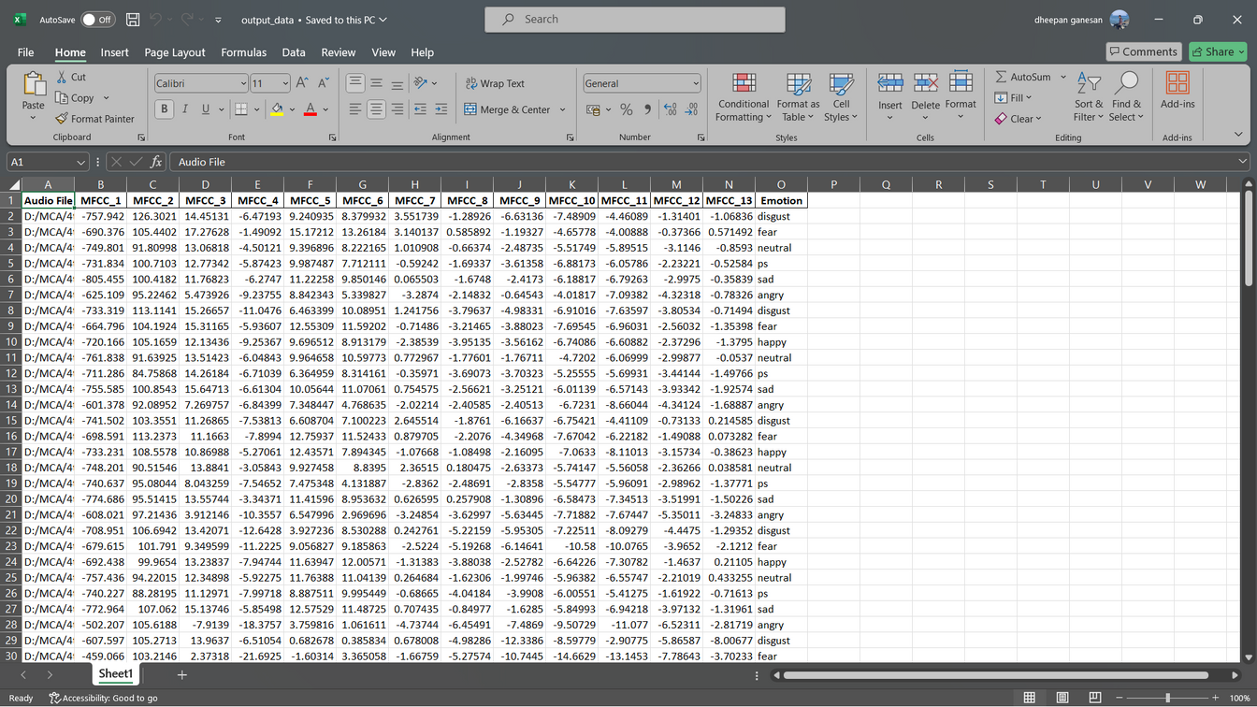
Feature Extraction
mfcc
Mel frequency cepstral coefficient
They are commonly used in speech and audio processing tasks such as speech recognition and speaker identification.

Slide 6
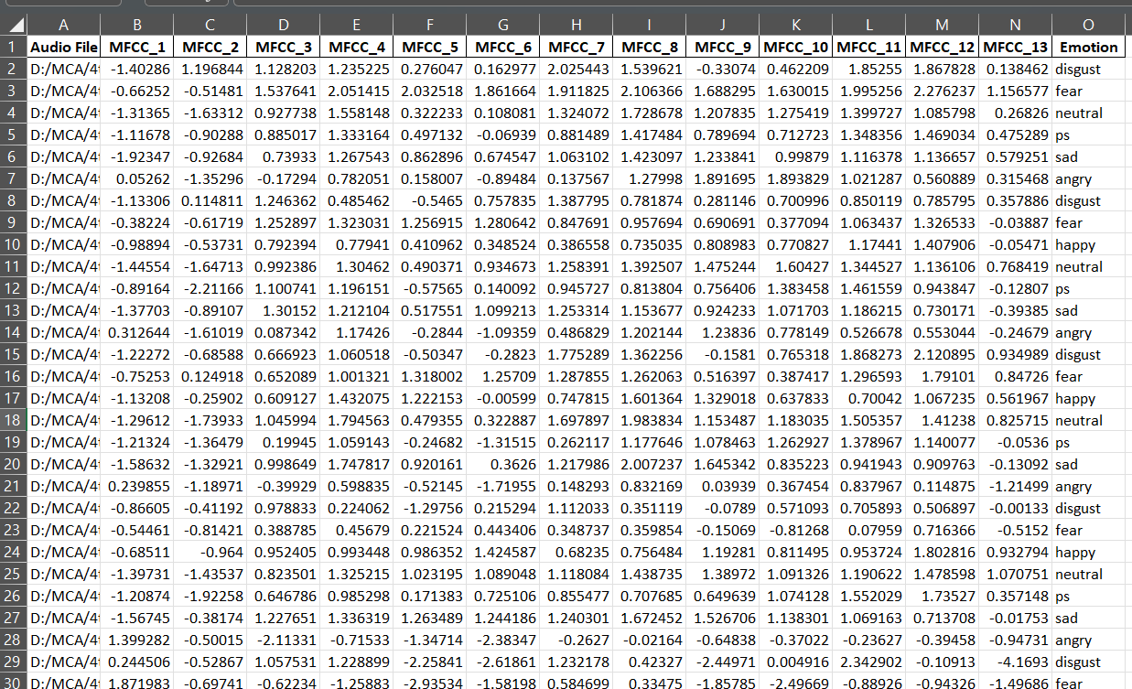
Feature Scaling
Feature Scaling
Here the values are scaled in a uniform way for further classification

Slide 7
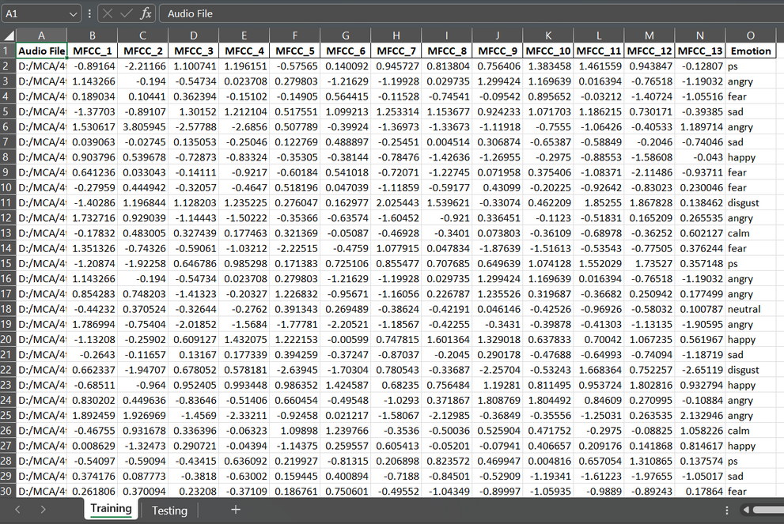
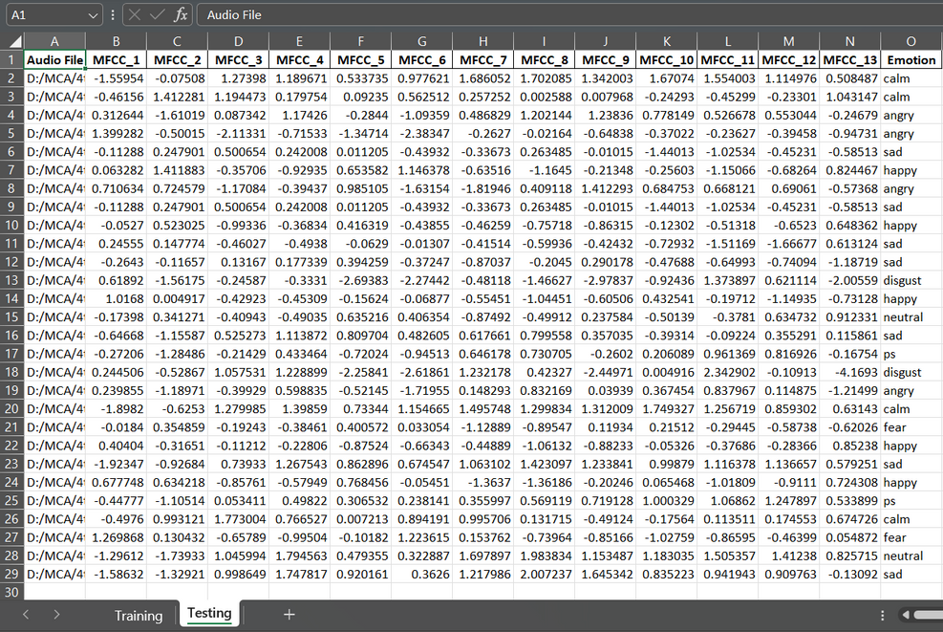
Split dataset
Testing phase
(20%)
Training phase
(80%)

Slide 8
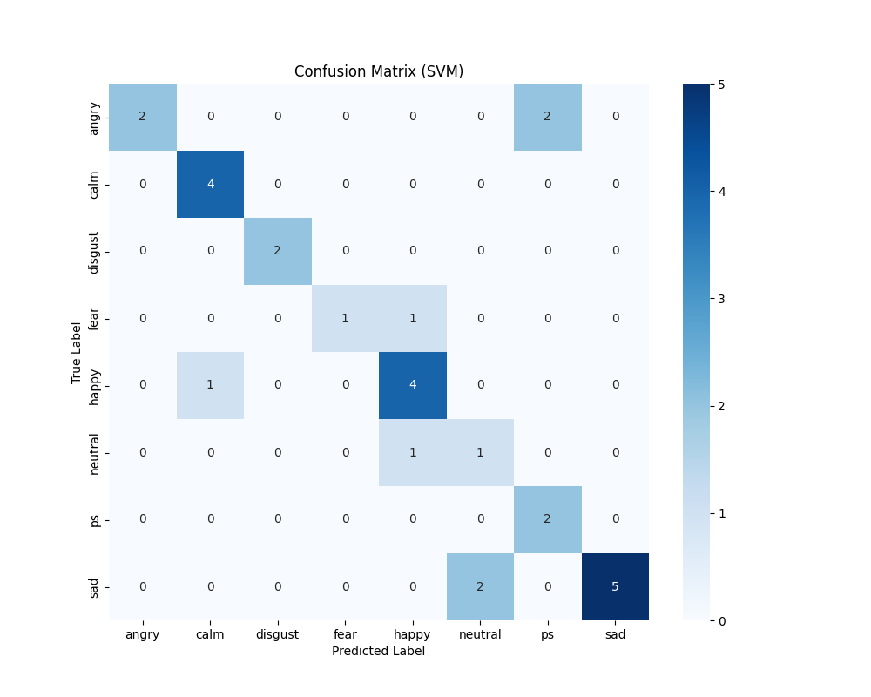
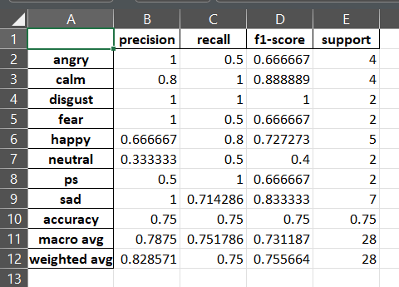
Audio classification & Confusion Matrix
Support Vector Machine(SVM)

Slide 9
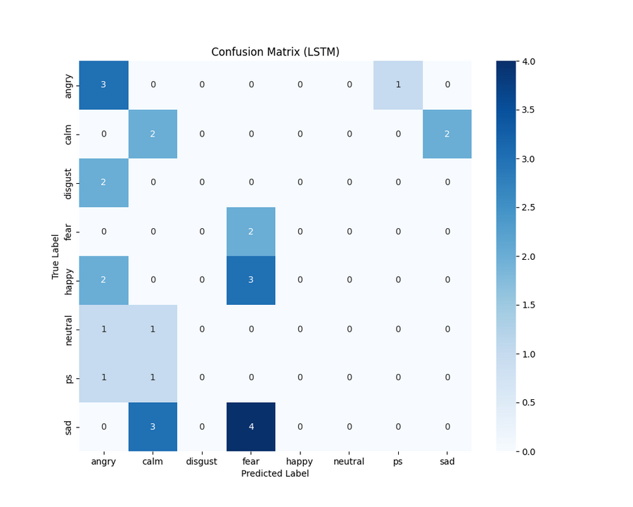
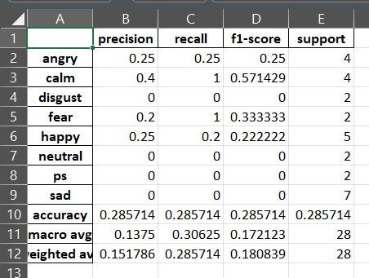
Audio classification & Confusion Matrix
Long short-term memory (LSTM)

Slide 10
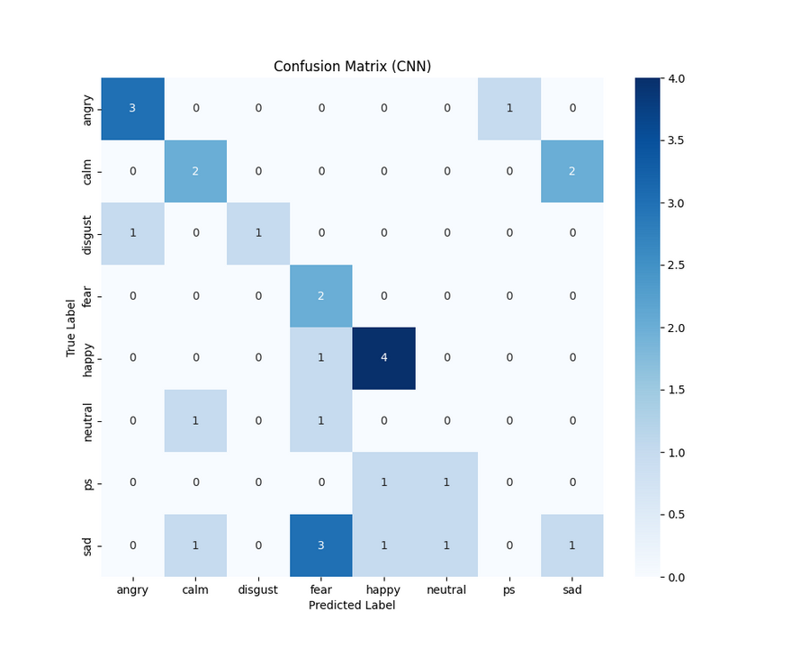
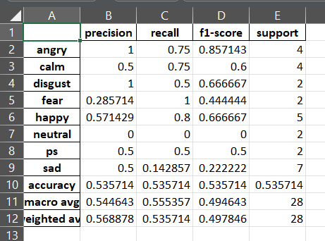
Audio classification & Confusion Matrix
Convolution Neural Network (CNN)

Slide 11
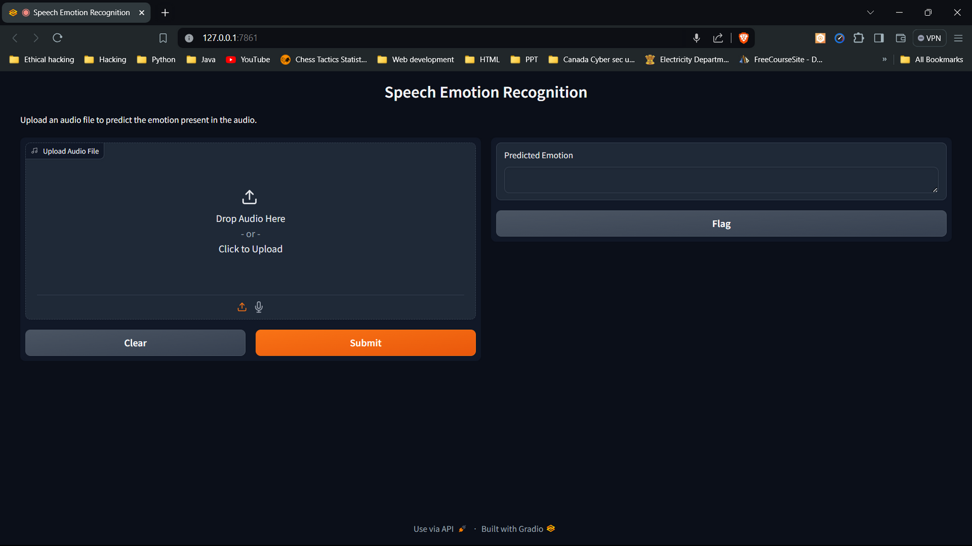
SER UI - To load a audio file and predict

Slide 12
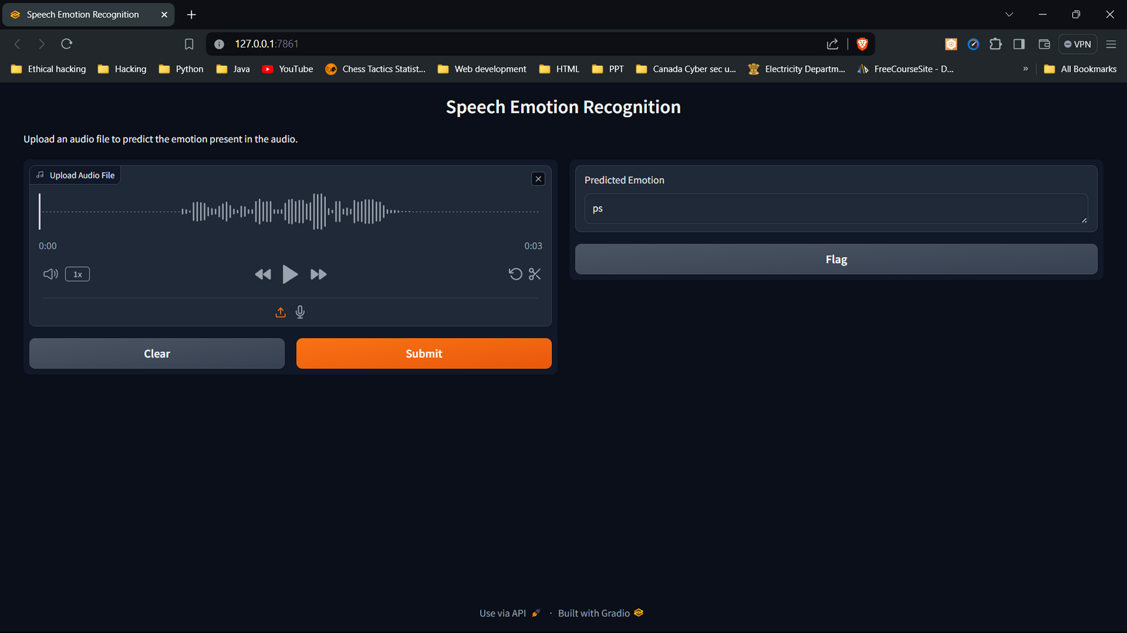
SER UI - audio file is loaded and predicted

Slide 13
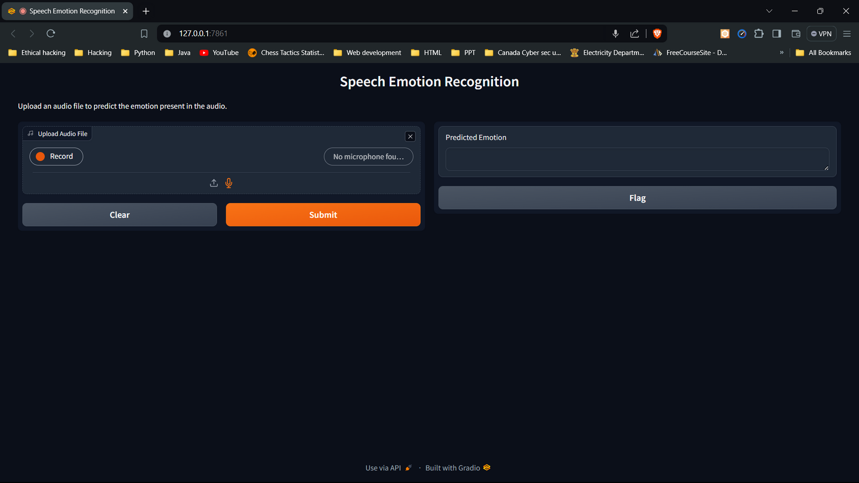
SER UI- To Record live voice and predict

Slide 14
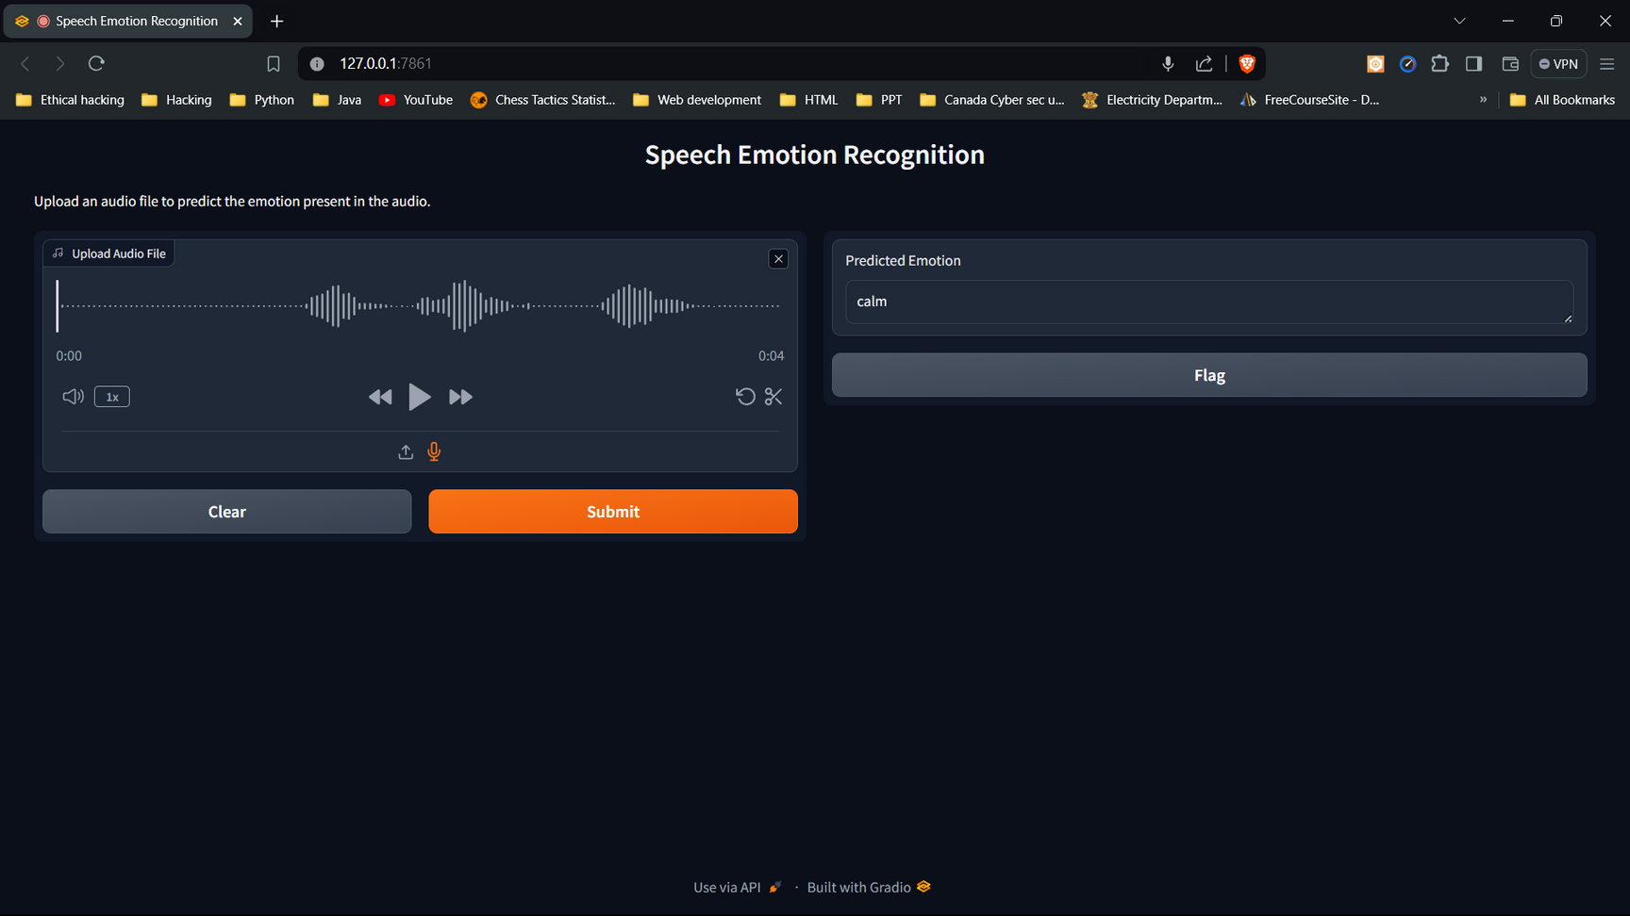
SER UI- live voice recorded and predicted

Slide 15
Conclusion
Based on the accuracy results of different models, SVM (Support Vector Machine) has proven to be the most accurate classifier for our speech emotion recognition task, with an accuracy of 0.75, compared to LSTM's 0.25 and CNN's 0.5. This high accuracy indicates that SVM effectively separates different emotional states in the feature space and performs well on our dataset.
To conclude, the SVM model has proven to be effective in enhancing the accuracy of speech emotion recognition. The Gradio interface makes the system user-friendly and accessible, allowing users to easily interact with the model and obtain emotion predictions.

